Slide 1
Baseband Digital signals and systems

Slide 2
The Digital Signals
The Source draws from an alphabet of M>=2 different symbols, and produces output symbols at some average rate r.
A typical computer terminal has approx M=90 and the users act as discrete source acting at approx r=5 symbols/sec or so.
However, the Computer itself works with just M=2 internal symbols, represented as LOW and HIGH electrical states called binary digits and r may be in the order of 10⁸ or so.

Slide 3
Fundamental limitations
Noise
  E_{b}/N₀ ratio determines quality. It was S/N in analog systems.
Bandwidth
  The Ch BW >= (signaling rate)/2
  For real time traffic (voice & video) ‘r’ determines the value of B, whereas, for non real time traffic (data) ‘B’ determines ‘r’
The performance is measured in terms of accuracy not the fidelity as done in analog systems.

Slide 4
Advantages of Digital Communication
Stability
In magnetic tape (analog hardware) the signals and its parameters are subject to change with component ageing, temp, and other environmental factors
whereas, USB (digital hardware) data is inherently time invariant

Slide 5
Continue…
Flexibility
  Improve Signal Fidelity
  Do error Correction/detection for improved accuracy
  Perform encryption for privacy and security
  Employ compression algorithms to remove redundancies
  Allow multiplexing different signal types: voice, video, text, picture etc.
  Algorithm for any of above operations can be easily and remotely modified.

Slide 6
Continue…
Reliable Reproduction
Analog systems employs amplifiers causing cumulative distortion, whereas, Digital systems uses regenerative repeaters.

Slide 7
A block diagram of digital communication system
1011
110010
Message
source
Source
coder
Error control
Line coder
Pulse
shaping
modulator
decision
detector
demodulator
channel

Slide 8

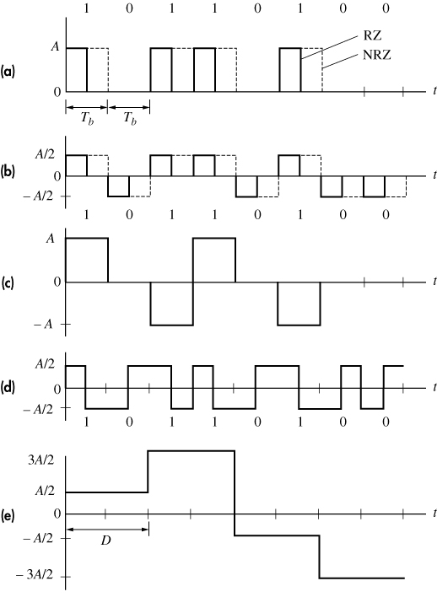
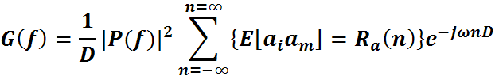
Binary PAM/ Line coding formats
unipolar RZ & NRZ
polar RZ & NRZ
bipolar NRZ
split-phase Manchester
polar quaternary NRZ

Slide 9
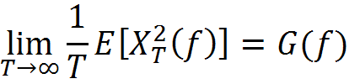
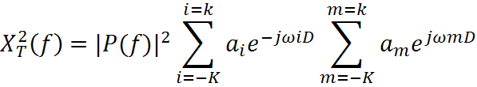
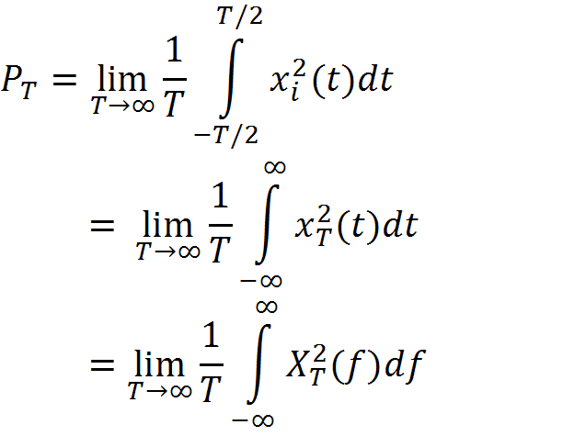


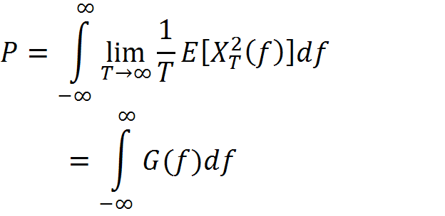
The power spectra estimation
Taking a sample of duration T thus x_{T}(t) = x_{i}(t) in duration T and 0 elsewhere
P = E [P_{T}]

Slide 10

Continue…
Polar coding (Independent symbols with zero mean)
R_{a}(n) = E[a_{i}.a_{m}] = E[a_{i}].E[a_{m}]=0.0 = 0; if i and m are unequal
= E[a_{i} a_{i}] = σ_{a}² when i=m i.e. n=0
_{Thus,}

Slide 11

Unipolar coding (independent symbols with mean = m_{a})
R_{a}(n) = E[a_{i}.a_{m}] = E[a_{i}].E[a_{m}]= m²_{a} ; if i and m are unequal
= E[a_{i} a_{i}] = σ_{a}² + m²_{a} ; when i=m i.e. n=0
Substituting above results and using POISSON’s sum formula,

Slide 12
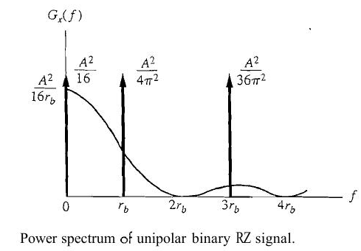

Continue…
Unipolar RZ with rectangular pulses
  Impulses are available at all odd harmonics thus easy synchronization
  In case of even harmonics (or all harmonics in NRZ case) impulses get multiplied by zero of the sinc shaped spectra.
  Heavy concentration around zero frequency (high DC component)

Slide 13
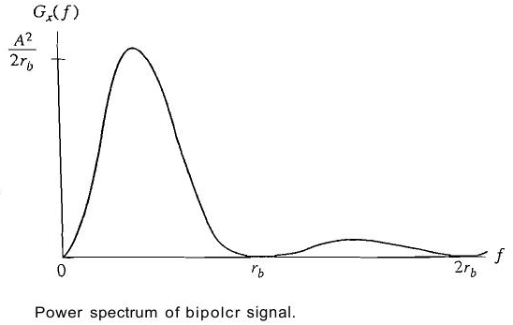

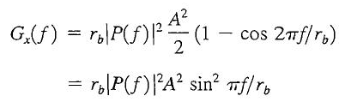
Spectral Shaping by precoding (AMI)
  Precoding creates 1 level dependence thus R_{a}(n=1) is not zero however it is zero for higher values of n.
  With equally likely 0’s and 1’s the probability of various symbols: P (a=0) = ½; P (a= +A) = P(a= -A) = ¼
  m_{a} = 0 (1/2x0 + 1/4xA + 1/4x(-A) =0)
  R_{a}(n=0) = A²/2 (1/2x(0)² + 1/4x(A)² + 1/4x(-A)²)
  Ra (n=1) = - A²/4 (1/4(+A)x1/2(-A) + 1/4(-A)x1/2(+A) +0+0+0+0)
  Obtain G(f) to see that the DC component is zero

Slide 14
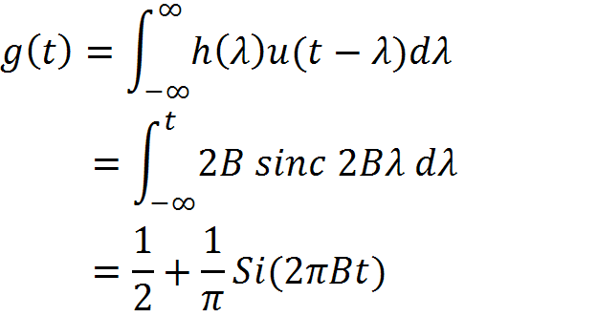
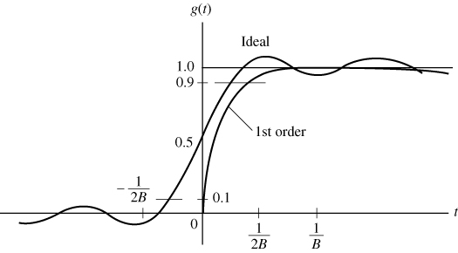
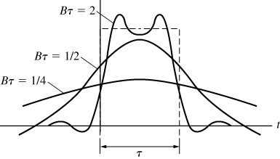
System’s Response to an abrupt transition
Let x(t)=u(t) and ideal filter h(t)=2Bsinc(2Bt), then
Precursor, overshoot and oscillations due to complete removal of all high frequency components but slightly high rise time (may be generalized to 1/2B)
B>= 1/2τ is the pulse resolution criterion used for designs.

Slide 15
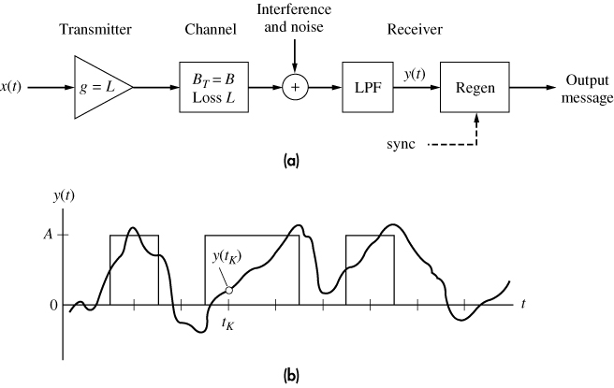
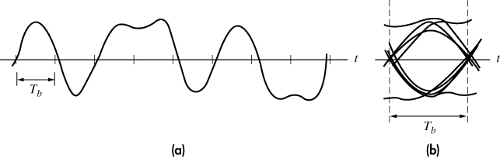


The Eye pattern: a measure of distortion
Inter symbol interference (ISI), Noise margin, Zero crossing jitter, Time sensitivity

Slide 16
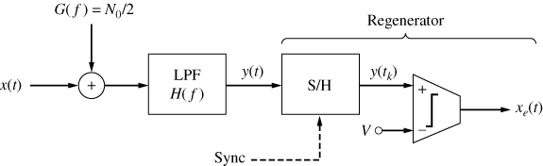
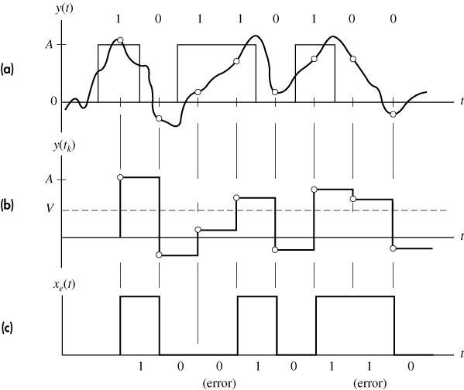
Reception and error probability
The Baseband binary receiver.
It includes a LPF for removing excess noise but how to minimize ISI?
Regeneration of a unipolar signal
(a) signal plus noise
(b) S/H output
(c) comparator output

Slide 17
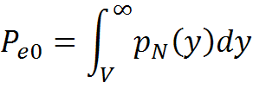

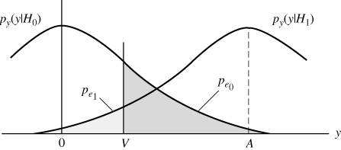
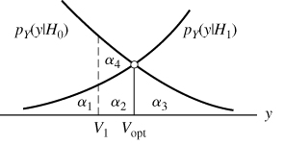
p(y/H0)= p_{N}(y) and p(y/H1) = p_{N}(y-A)
P_{e} = P(H0).P_{e0} + P(H1). P_{e1}
V should be chosen such that P_{e} can be minimized
i.e. d/dV (P_{e}) = 0.
For equally likely symbols, it will occur at
p(y/H0) = p(y/H1) (at V=A/2 in present case)
which makes P_{e} = P_{e0} = P_{e1} = Q (A/2σ)
(In normal distribution P(y> m+kσ) = Q(k); here m+kσ = A/2 thus k= A/2σ since m=0 )
Continue…
M-Ary error probability?

Slide 18
S/N performance of Line coding
(A/2σ)² = A²/4σ² = A²/4N_{R} since σ²=N_{R}
Unipolar NRZ:
  S_{R}= (1/2D)(A²D+0.D)=A²/2
  P_{e} = Q(sqrt (1/2)(S/N)_{R})
For same SNR, the polar signals will have low error rate.
N_{R}=N₀B_{N} = N₀r_{b}/2 i.e. rapid signaling increases N_{R} thus need more S_{R} for maintaining same P_{e}.
The Symbol energy; E_{b}=S_{R}.D = S_{R}/r_{b} thus Pe is measured in γ_{b}=E_{b}/N₀ to accommodate both S_{R} and r_{b} simultaneously.
Polar NRZ:
  S_{R}= (1/2D)[(A/2)²D+(-A/2)².D]=A²/4
  P_{e} = Q(sqrt ((S/N)_{R}))

Slide 19




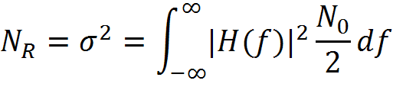
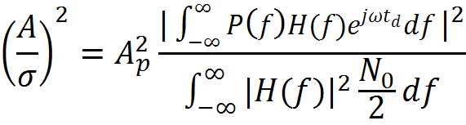
The Optimum Filter
The LPF (used to remove excess noise) at Rx should minimizes P_{e}=Q(A/2σ) i.e. maximizes (A/2σ) for optimal filtering. The pulse shape is known to it but amplitude (A_{p}) and arrival time (t₀) is unknown.
When x_{R}(t) is passed through h(t), it should generate amplitude level A at t=t₀+t_{d}.
The synchronization circuit should generate t₀ and t_{d} should be selected by the designer which should be less than pulse width (τ).
The H(f) which maximizes RHS should be an optimum filter

Slide 20

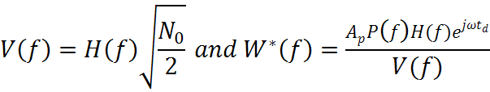
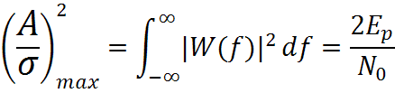
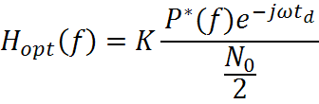

Continue…
These substitutions reduces RHS into known form of frequency domain Schwarz inequality. Which is upper bounded by energy of W(f)
It brings out the significance of energy for pulse detection
Schwarz inequality becomes equality when V(f) and W(f) are proportional i.e. V(f)=K.W(f)
Shape of h(t) should be same as p(t) but reversed in time and shifted by t_{d} thus called matched filter. t_{d} Should be sufficient to make the filter realizable.

Slide 21
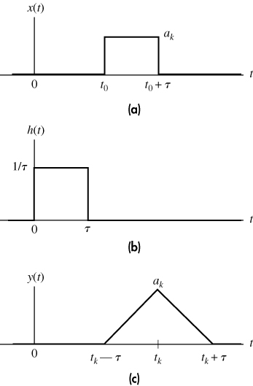
Continue…
Matched filtering with rectangular pulses
(a) received pulse
(b) impulse response
(c) output pulse
Integrate and dump filter is a practical realization of the matched filters which ensures no ISI.
Correlator is another alternative.
Optimum terminal filters are used for bandlimited pulse transmission which has same upper bound as matched filters. It is used with Nyquist pulses.
What about ISI produced by it?

